Slide 1

HOW CAN A WELLNESS TECHNOLOGY COMPANY PLAY IT SMART ?
Google data analytics professional certificate capstone project
Achuth Akilesh

Slide 2
About Bellabeat
Bellabeat- a high-tech manufacturer of health-focused products for women – feels the potential to become a larger player in the global smart device market.
One of its product is, "Time" is a wellness watch which tracks your health using smart technology.
"Time", tracks user activity, sleep and stress
The watch is connected to the Bellabeat app, which provides users with insights into their daily wellness.

Slide 3
Business Task
Bellabeat is a successful small company, but they have the potential to become a larger player in the global smart device market. Urška Sršen, cofounder and Chief Creative Officer of Bellabeat, believes that analysing smart device fitness data could help unlock new growth opportunities for the company.

Slide 4
Data Source Used
The dataset used for this case study is FitBit Fitness Tracker Data, which is available in Kaggle and was made available through Mobius.
This dataset generated by respondents to a distributed survey via Amazon Mechanical Turk between 03.12.2016-05.12.2016.
Fitbit users consented to the submission of personal tracker data, including minute-level output for physical activity, heart rate, and sleep monitoring.
Variation between output represents use of different types of Fitbit trackers and individual tracking behaviours / preferences.

Slide 5
Credibility & Integrity of Data
Due to the limitation of size (30 users) and not having any demographic information we could encounter a sampling bias.
We are not sure if the sample is representative of the population as a whole.
Another problem we would encounter is that the dataset is not current and also the time limitation of the survey (2 months long).
That is why we will give our case study an operational approach.

Slide 6
Findings

Slide 7
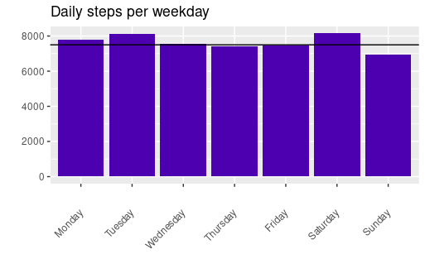
Daily Steps per weekday
In this graph, we can deduce that users take recommended number of 7500 steps a day except for Sundays.

Slide 8
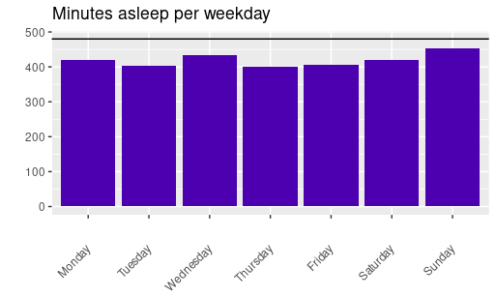
Minutes asleep per weekday
In this graph, we can deduce that users don't take the recommended amount of sleep of 8 hours

Slide 9
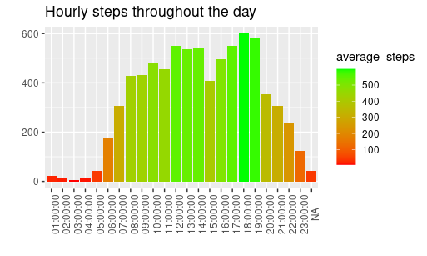
Hourly steps throughout the day
Users are more active from 8am to 7pm and they walk more steps from 12pm to 2pm during lunch and 5pm to 7pm in the evening.

Slide 10
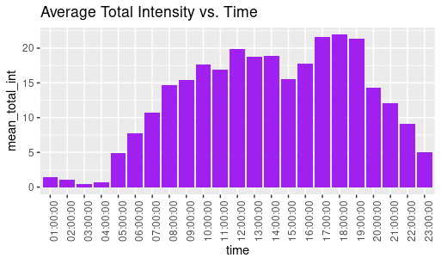
Hourly intensities throughout day
Most of the activity happens between 5 pm and 7 pm - I suppose that when people are done with work for the day, they go to the gym or take a walk. We can use this period of time to remind and motivate users to go for a run or walk using the Bellabeat app.

Slide 11
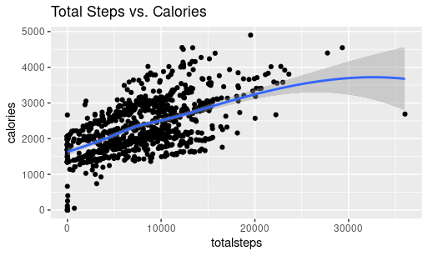
Correlations
From this graph, we can deduce that there is a positive correlation between steps and calories burned. The more number of steps walked, the more calories are burnt.

Slide 12
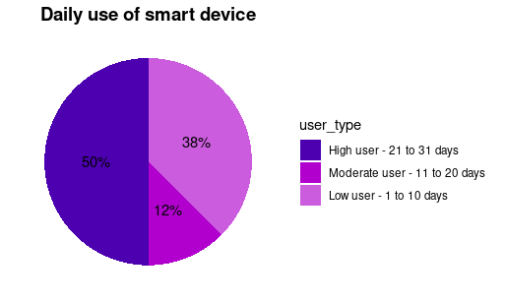
Usage of Smart Device
From this visualization we can deduce that:
50% of the users of our sample use their device frequently - between 21 to 31 days.
12% are moderate users (they use their device for 11 to 20 days).
38% of our sample rarely used their device.

Slide 13
Recommendations for the app

Slide 14
Daily notification on steps taken
According to the Centers for Disease Control and Prevention, taking 8,000 steps per day is linked to a 51% lower risk of all-cause mortality, while 12,000 steps can lead to a 65% lower risk compared to 4,000 steps. Bellabeat can promote this by encouraging users to reach the 8,000-step goal through daily notifications at various times, helping them stay aware of their progress. The app can also educate users on the health benefits of walking the recommended daily steps.

Slide 15
Daily reminders about sleep
Based on my analysis, it appears that users are getting less sleep than recommended. We could implement a feature in the app that allows users to set a preferred bedtime and receive a notification a few minutes in advance to help them prepare for sleep, or even set an alarm to go to bed.

Slide 16
Enhancing User Engagement through Personalized Prompts
By leveraging hourly and daily metrics, we can enhance user engagement by sending prompts that compare their progress to others in their age, location, and gender groups. We can celebrate users for hitting their targets or motivate them to strive for more. Here are some example prompts/push notifications:
"You’ve just achieved a personal best! Great job on your longest walk yet!"
"Keep going! You’re nearly as active as you were at this time last week!"
"You’re not alone! You’re in the top 50% for active minutes this week!"
"Take some time to rest! Recovery is just as crucial as your workouts."

Slide 17
Incentive program
We can establish an incentive program based on user activity within the app. The app could include different stages to achieve based on the number of steps walked each day, while also incorporating a recommendation for the ideal number of hours of sleep. Users would need to maintain their activity level and sleep duration for a specific period, perhaps a month, to advance to the next level.
For each level attained, users would earn a certain number of points that could be converted into discounts on other Bellabeat products, exclusive access to premium features, or entry into special contests for larger rewards. Additionally, users could receive personalized fitness tips or early access to new product launches as they reach higher levels.

Slide 18
Thank You!

